Slide 1
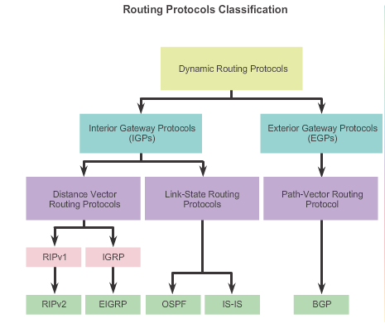

Slide 2

EIGRP Fundamental
Enhanced distance vector
Commonly found in enterprise networks
EIGRP is a derivative of Interior Gateway Routing Protocol (IGRP)
Variable-Length Subnet masking(VLSM)
Initially, EIGRP was a cisco Proprietary Protocol
It was released to the Internet engineering Task force (IETF) through RFC 7868, which was ratified in may 2016
EIGRP uses a diffusing update algorithm (DUAL)
  Route Flag: D (AD=90 (Internal EIGRP ))
  D EX (AD=170 ( External EIGRP)

Slide 3
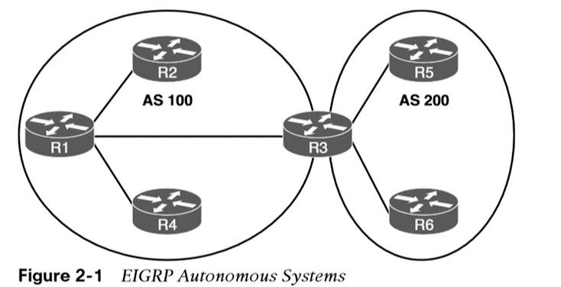
Autonomous Systems
A router can run multiple EIGRP processes. Each process operates under the context of an autonomous system.
An autonomous system (AS) is a very large network or group of networks with a single routing policy. Each AS is assigned a unique ASN, which is a number that identifies the AS

Slide 4
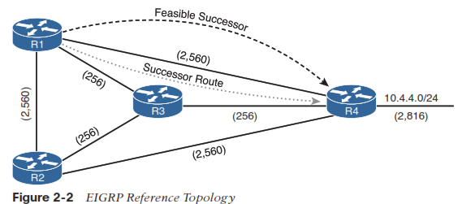
EIGRP Terminology
Successor route
  - The route with the lowest path metric to reach a destination.
Successor:
  - The best path to the destination is called the successor.
Feasible distance (FD):
  - The total distance to the destination.
Reported distance (RD)
  - Total distance from the neighbor to the destination.
Feasibility condition
  - Advertised distance of feasible successor < Feasible distance of successor.
Feasible successor
  - A route with that satisfies the feasibility condition is maintained as a backup route.

Slide 5
EIGRP Tables
EIGRP Neighbour Table | Lists all directly connected neighbors Next hop Router Interface
EIGRP Topology Table | Lists all learned routes from all EIGRP neighbors Destination Metric
EIGRP Routing Table | Best routes from EIGRP topology table will be copied to the routing table

Slide 6
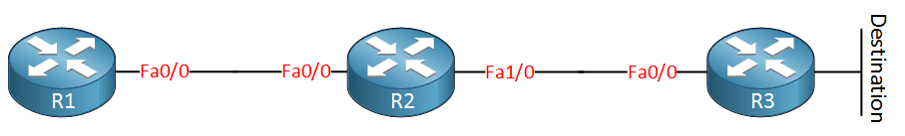
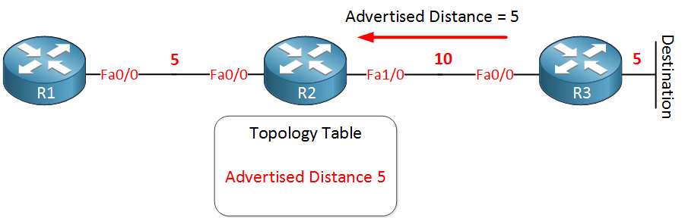
EIGRP Best Path Selection

Slide 7
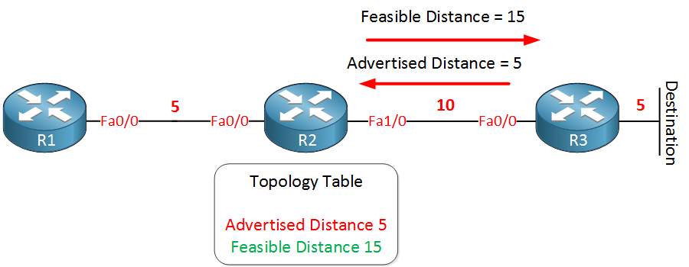
EIGRP Best Path Selection

Slide 8
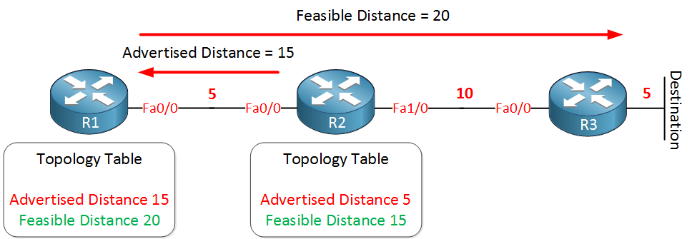
EIGRP Best Path Selection

Slide 9
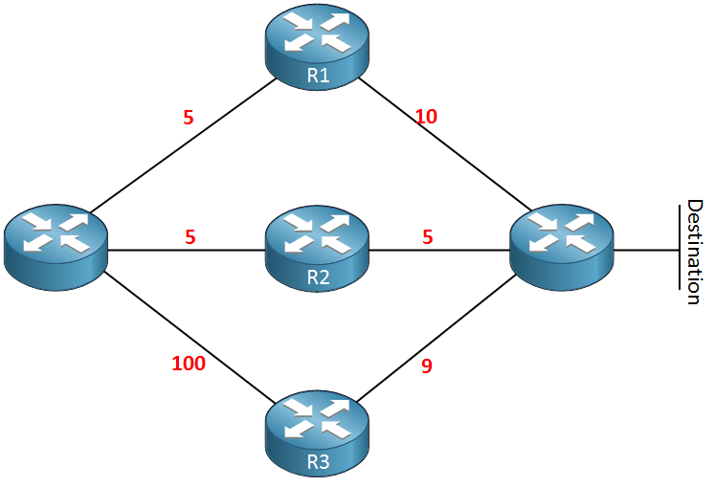
EIGRP Best Path Selection
Router | Advertise Distance | Feasible Distance
R1
R2
R3

Slide 10
EIGRP Packets
Hello packets: are used for neighbor discovery
Update packets: have routing information and are sent reliable to whatever router that requires this information.
Query packets: are used when your EIGRP router has lost information about a certain network and doesn’t have any backup paths.
Reply packets: are used in response to the query packets.
ACK packets: are used to acknowledge the receipt of update, query and reply packets.

Slide 11
EIGRP Neighbor Table
R1#show ip eigrp neighbors
IP-EIGRP neighbors for process 1
H Address Interface Hold Uptime SRTT RTO Q Seq
(sec) (ms) Cnt Num
0 192.168.12.2 Fa0/0 10 00:06:06 19 200 0 27
H (Handle)
Hold: (sec)
Uptime
SRTT (Smooth round-trip time)
RTO (Retransmission timeout)
Q Cnt (Q count)
Seq Num (Sequence number)

Slide 12
EIGRP Topology table
R1#show ip eigrp topology
IP-EIGRP Topology Table for AS(1)/ID(1.1.1.1)
Codes: P - Passive, A - Active, U - Update, Q - Query, R - Reply,
r - reply Status, s - sia Status
P 2.2.2.0/24, 1 successors, FD is 156160
via 192.168.12.2 (156160/128256), FastEthernet0/0
Passive
Active
Reply Status
Sia Status (Stuck in Active)

Slide 13
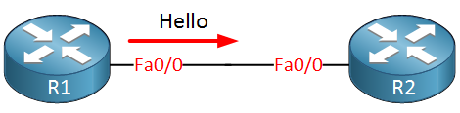
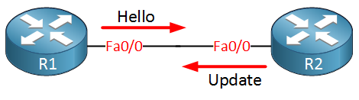
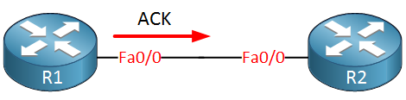
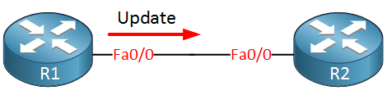
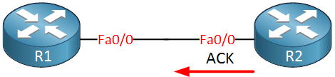
EIGRP Neighbor Adjacency

Slide 14
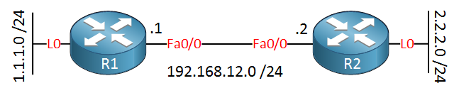
EIGRP Neighbor Adjacency
Neighborship Condition
  Same AS Number
  Same Subnet Number
  Authentication [Optional] > MD5
  Same K Values

Slide 15
Basic EIGRP Config
EIGRP
  Classic/Traditional
  Named
Classic:
  router(config)# router eigrp ASN
  router(config-router)# network INTERFACE_IP [WC-MASK]
  router(config-router)# eigrp router-id A.B.C.D
Named:
  router(config)# router eigrp name
  router(config-rotuer)# address-family ipv4 unicast autonomous-system ASN
  router(config-router-af)# network INTERFACE_IP [WC_MASK]
  router(config-router-af)#eigrp router-id A.B.C.D
  router(config-router-af)# exit-address-family

Slide 16
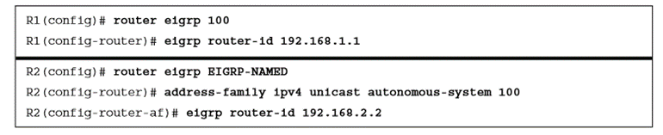
EIGRP Router ID
The router ID (RID) is a 32-bit number that uniquely identifies an EIGRP router.
The RID can be set dynamically, which is the default, or manually.

Slide 17
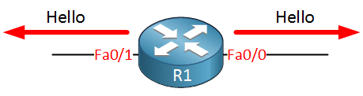
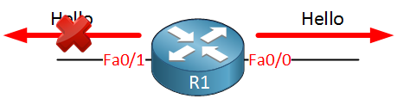
Passive Interfaces
Some network topologies must advertise a network segment into EIGRP but need to prevent neighbors from forming adjacencies with other routers on that segment.
In this scenario, we need to put the EIGRP interface in a passive state.
Passive EIGRP interfaces do not send out or process EIGRP hellos, which prevents EIGRP from forming adjacencies on that interface.

Slide 18
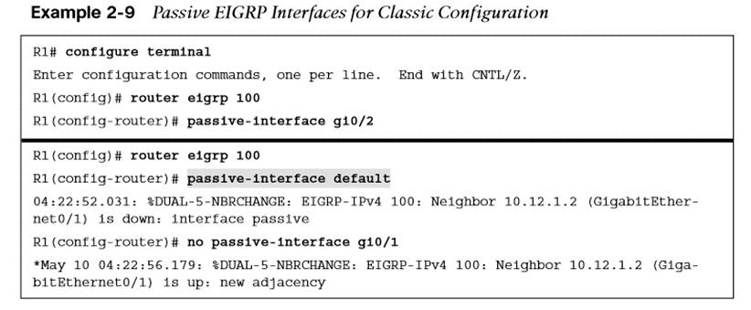
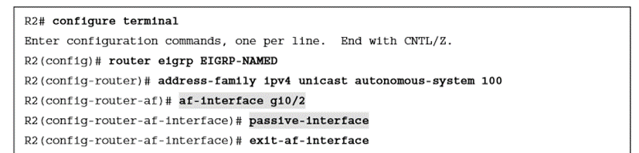
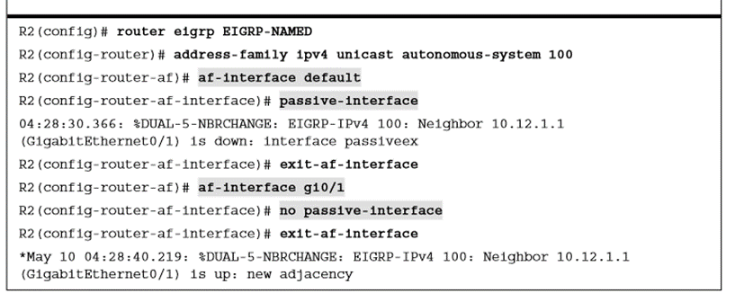
Passive Interfaces(Cont.)

Slide 19
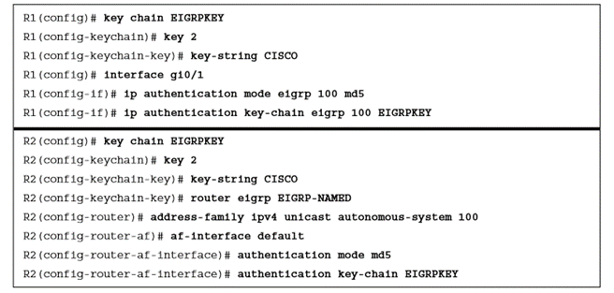
EIGRP Authentication
Authentication is a mechanism for ensuring that only authorized routers are eligible to become EIGRP neighbors.
Authentication prevents adding a router to a network and introducing invalid routes, accidentally or maliciously.

Slide 20
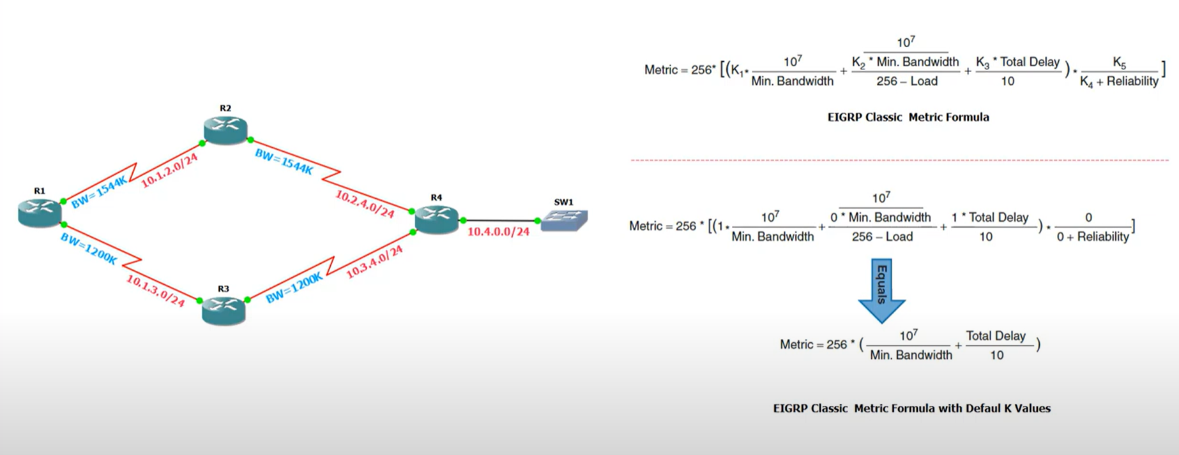
EIGRP Metric Calculation

Slide 21
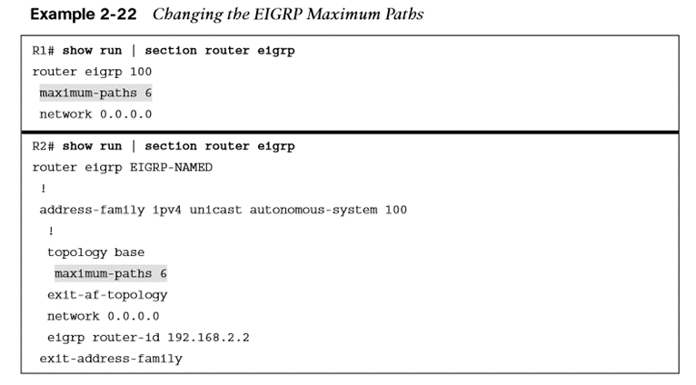
Load Balancing
EIGRP allows multiple successor routes (with the same metric) to be installed into the RIB. Installing multiple paths into the RIB for the same prefix is called equal-cost multipathing (ECMP) routing.
The default maximum ECMP is four routes.

